Slide 1
CSE7302 - INTERNSHIP Review-4 Presentation ITDA Audit
Student Details
Name | TANUSHREE R
Roll No | 20221CBD0029
Section | 8CBD01
Under the Supervision of,
Ms. Sandhya L
Assistant Professor - PSCS
Presidency School of CSE
Presidency University
Name of the Program: B.Tech
Name of the HoD: Dr. S. Pravinthraja
Name of the Program Internship Coordinator: Mrs. Nisha Robin Rohit
Name of the School Internship Coordinator: Dr. Geetha A

Slide 2
Content
About Company or Organization
Working domain or the technology
About your team and reporting Manager
Challenges Faced in Internship
Objectives of the work
Literature Review
Proposed System
Problem Statement
System Requirements
Advantages of Proposed System/Work
System Design
System Implementation
System Testing
Conclusion
References
Github Link

Slide 3
About Company or Organization
Company:
Deloitte Haskins & Sells Chartered Accountants LLP.
Function:
Audit & Assurance (IT, Data & Analytics - ITDA).
Role:
Capability & Enhancement Center (CEC) focus.
Core Business:
Global leader in providing professional services, including audit, consulting, and risk advisory.

Slide 4
Working domain or the technology
Domain:
IT Audit (focus on Information Technology General Controls - ITGC).
Environment:
Enterprise Resource Planning (ERP) systems (SAP, HANA, LINUX).
Core Tools:
Deloitte Omnia: Centralized cloud-based audit ecosystem.
ACTT:
Automated Control Testing Tool – Fore Data Processing.
Advanced Excel:
Logic-based sampling with Sampling Frequency.

Slide 5
About your team and reporting Manager
Department:
IT, Data & Analytics (ITDA) - Audit & Assurance.
Structure:
Worked under a designated Manager within the CEC team.
Collaboration:
Partnered with various Location Managers and Single Points of Contact (SPOCs) for evidence collection and system validation.

Slide 6
Challenges Faced in Internship
Data Integrity:
Heavy reliance on client-provided raw data quality.
Business Justification:
Interpreting complex client explanations for identified control gaps.
Resource Management:
Managing strict, time-bound engagement deadlines and archival requirements.
Technical Barriers:
Handling system downtime in SAP/Linux environments during data extraction.

Slide 7
Objectives of the work
System Management:
Standardize and digitize the audit lifecycle via Deloitte Omnia.
Security:
Validate Access Security (Provisioning/SoD) across SAP, HANA, and LINUX.
Analysis:
Apply quantitative sampling (UAM,CM and RC) using Excel-based automated logic.
Behavior:
Monitor system logs (SM37, UNIX logs) for failed jobs and unauthorized executions.
Deployment:
Execute DQA Review roadmap for accurate workpaper archival.

Slide 8
Literature Review
Key Research:
Leveraged methodologies from Auditing and GRC Automation in SAP
Key Findings:
Automated internal control testing improves detection rates by 20–70% over manual methods.
Shift toward "Full Population Auditing" using ML vs. traditional manual sampling.
Real-time GRC integration reduces audit burden by approximately 20 working days.

Slide 9
Proposed System / Work
Approach:
Data-driven audit analytics using the Deloitte Omnia ecosystem.
Methodology:
Four-stage Audit Lifecycle (Planning, Fieldwork, Concluding, Archiving).
Testing Strategy:
Dual-phase validation (Design & Implementation testing followed by Operating Effectiveness testing).

Slide 10
Problem Statement
Manual Bottlenecks:
Previous audits relied on non-structured MS Office files and fragmented workflows.
Limited Visibility:
Disconnected tracking systems led to poor visibility into engagement files.
Inconsistency:
Lack of standardized sampling led to potential errors in detecting Segregation of Duties (SoD) conflicts.
Efficiency:
Manual extraction of SAP/LINUX logs (SM50, SM36) was time-consuming and prone to human error.

Slide 11
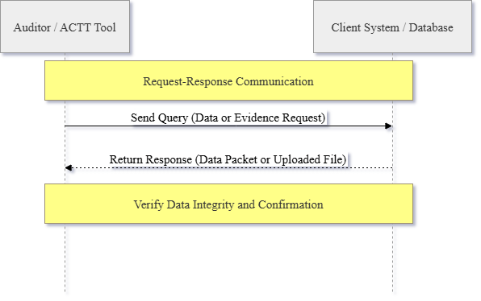
System Requirements

Slide 12
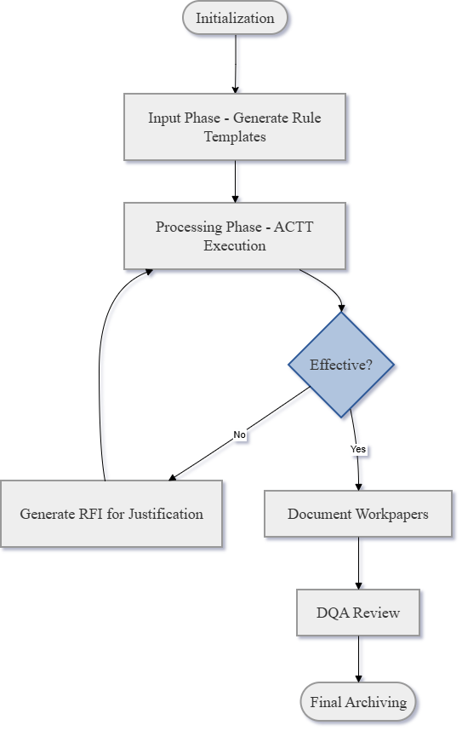
System Requirements

Slide 13
System Requirements
Input:
Raw system logs, Audit Rule Templates, Client Policies.
Process:
ACTT engine for data ingestion, validation, and systematic sampling.
Output:
Populated report files, RFI documentation, and 2342S Deficiency Reports.
Security:
Multi-Factor Authentication (MFA) and TLS-encrypted data transfer via D-connect.

Slide 14
Advantages of Proposed System/Work
Efficiency:
Automated testing reduced manual intervention in sampling/validation.
Accuracy:
100% sample selection accuracy in observed testing via advanced logic.
Transparency:
Real-time monitoring of engagement diagnostics via Omnia/ITS Tracker.
Sustainability:
Shift to paperless, cloud-based auditing reducing physical waste and travel.

Slide 15
System Design
Methodology:
V-Model (Validation & Verification).
Functional View:
Organized into 6 groups: Device, Communication, Services, Management, Security, and Application.
Logical Flow:
Raw Data -> Rule Templates -> ACTT Processing -> Deficiency Report (2342S) -> Workpaper Documentation.

Slide 16
System Implementation
Rule Templates:
Standardized server parameters (SAP version, T-codes) for ACTT processing.
Script Execution:
Processing client files through ACTT to identify authorized vs. unauthorized access.
Integration:
Combining all the testing procedures with received valid evidences.

Slide 17
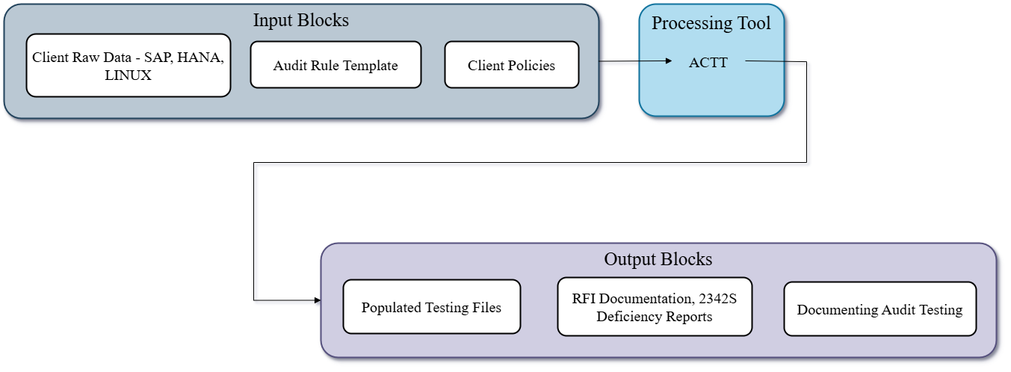
System Implementation

Slide 18
System Testing
Test Points:
By referring sampling procedure
Validation:
Used Power BI runs to verify the changes.
Results:
Observed matches between design/expected values and actual test results (100% accuracy).

Slide 19
Conclusion
Successfully executed ITGC testing using a standardized, automated V-Model approach. Validated access security and change management controls; achieved zero unresolved alerts. Transition to Full Population Auditing and integrate ML-based predictive analytics for SoD conflict detection.

Slide 20
References
[1] Oko-Odion, C. and Udoh, O.R., 2024. Leveraging technology in internal audit processes for streamlined management and risk oversight. International Journal of Science and Research Archive, 13(2), pp.3077-3100.
[2] . El Arass, M., Tikito, I. and Souissi, N., 2018, June. An audit framework for data lifecycles in a big data context. In 2018 International Conference on Selected Topics in Mobile and Wireless Networking (MoWNeT) (pp. 1-5). IEEE.
[3] Chuprunov, M., Bachmann, R. and Nowatzki, A., 2013. Auditing and GRC Automation in SAP (pp. I-XXXII). Berlin: Springer.

Slide 21
Github Link
https://github.com/tanushreer-7/8-sem-internship

Slide 22
Q&A

Slide 23
Thank you !!

